Slide 1
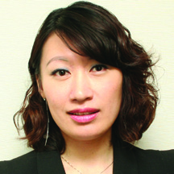
TLS健康生活纖營計劃及TLS®健康生活纖形比賽
TLS® & Fit Your Fit Challenge
Emmy Yeung
產品拓展經理 Product Manager

Slide 2
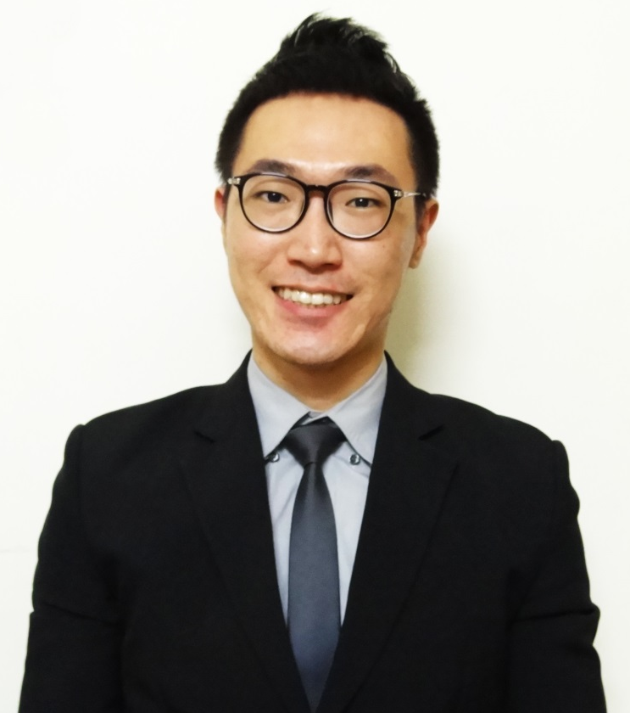
TLS健康生活纖營計劃及TLS®健康生活纖形比賽
TLS® & Fit Your Fit Challenge
Jason Lam
產品拓展主任 Product Officer

Slide 4
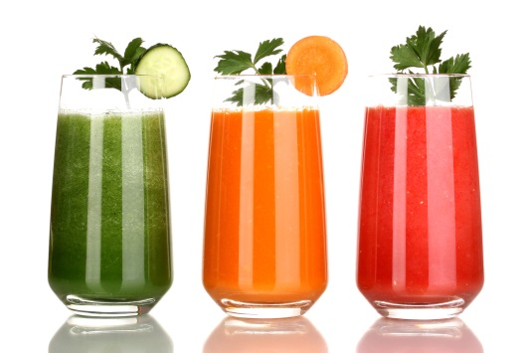
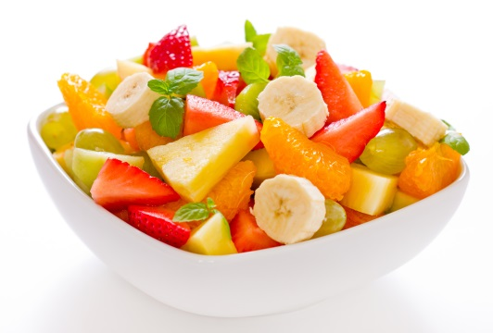
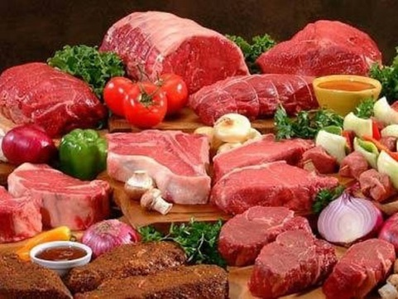
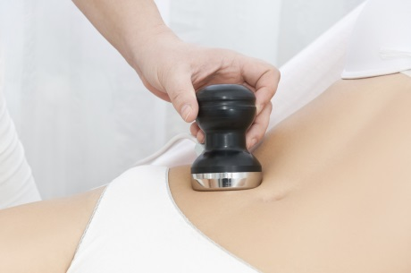
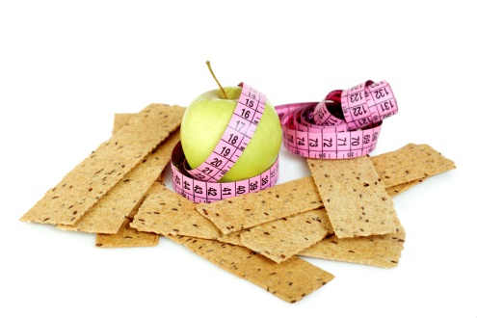
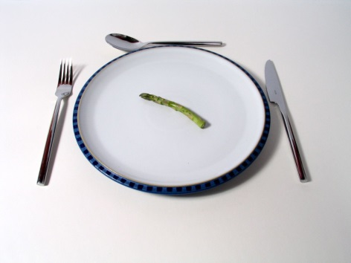
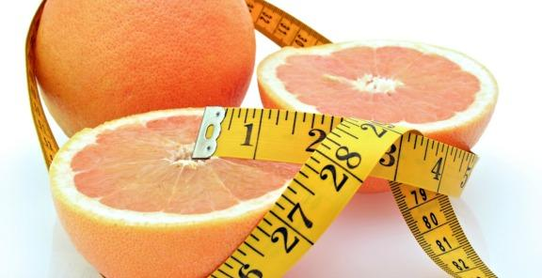
減肥市場是不停變化及增長
The Weight Loss Market is a moving target
START LIVING WITH TLS TODAY
#FINDYOURFIT
#TLSWEIGHTLOSS

Slide 5
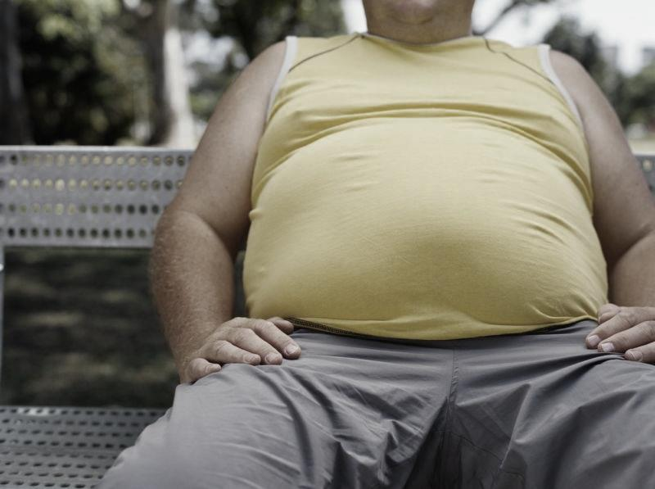
香港超重或肥胖人士
OVERWEIGHT / OBESE PEOPLE
5個人中就有2個
2 IN 5 PEOPLE IN HK
香港衛生署行為風險因素監測數字（2014年4月）Statistics on behavioral risk factors (April 2014), Department of Health http://www.chp.gov.hk/tc/data/1/10/280/3994.html
START LIVING WITH TLS TODAY
#FINDYOURFIT
#TLSWEIGHTLOSS

Slide 6
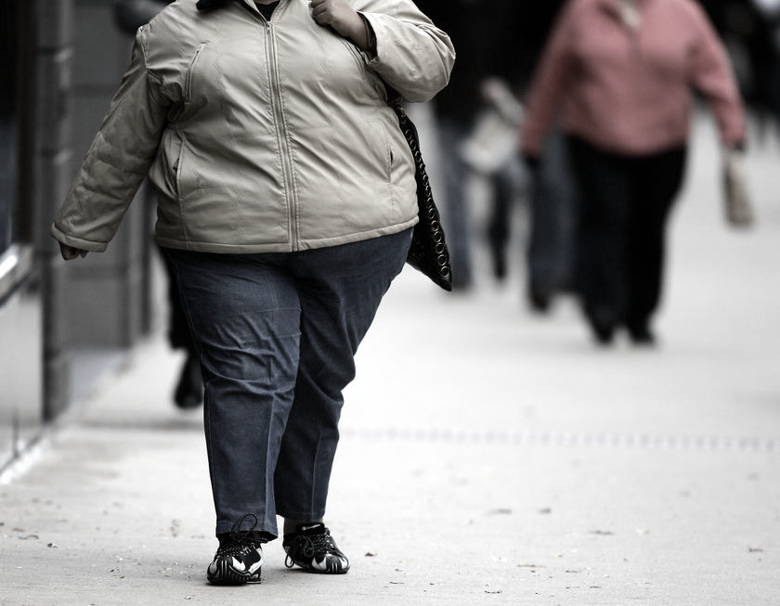
香港超重或肥胖女士
OVERWEIGHT / OBESE WOMEN
3個人中就有1個
1 IN 3 WOMEN IN HK
香港衛生署行為風險因素監測數字（2014年4月）Statistics on behavioral risk factors (April 2014), Department of Health http://www.chp.gov.hk/tc/data/1/10/280/3994.html
START LIVING WITH TLS TODAY
#FINDYOURFIT
#TLSWEIGHTLOSS

Slide 7
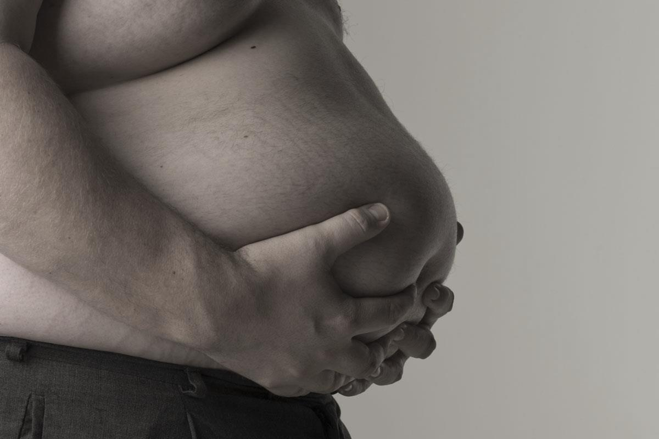
香港超重或肥胖男士
OVERWEIGHT / OBESE MEN
2個人中就有1個
1 IN 2 MEN IN HK
香港衛生署行為風險因素監測數字（2014年4月）Statistics on behavioral risk factors (April 2014), Department of Health http://www.chp.gov.hk/tc/data/1/10/280/3994.html
START LIVING WITH TLS TODAY
#FINDYOURFIT
#TLSWEIGHTLOSS

Slide 8
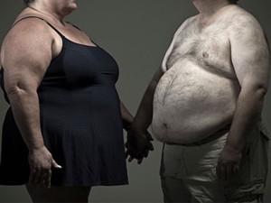
肥胖就是「病」! Obesity is a “disease”
二型糖尿病
高血脂
中風
高血壓
冠心病
睡眠窒息症
膽石
癌症
關節炎
脂肪肝
痛風症
Type II diabetes
High cholesterol
Stroke
High blood pressure
Coronary Heart Disease
Sleep Apnea
Gallstone
Cancer
Arthritis
Fatty liver
Gout

Slide 9
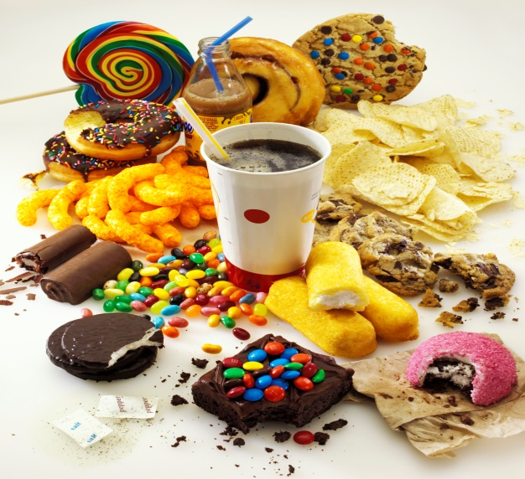
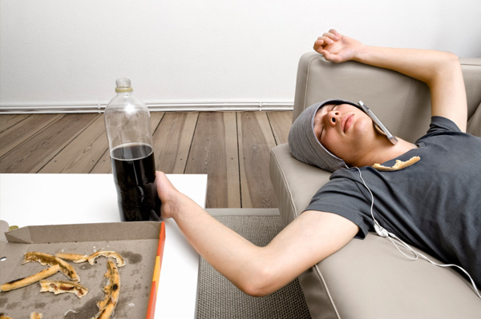
但大部份人都仍然做一些錯的事情
But we continue to do the wrong things
不正確的食物選擇
Poor Food Choices
活動量不足
Inactive
低頭一族
Screen Time
START LIVING WITH TLS TODAY
#FINDYOURFIT
#TLSWEIGHTLOSS

Slide 10
為何選擇TLS®健康生活纖營計劃 Why TLS® Weight Loss Solution
全面及個人化的減重計劃
重塑及改善新陳代謝
減去體重、脂肪及身體多餘尺寸
持續成功的減重方案
Comprehensive & customized program
Rebalance and improve metabolism
Lose Weight, fat and inches
Ultimate weight management solution

Slide 11
3大成功要素 3 COMPONENTS OF TLS®
身體構成
Body Composition
行為修正 Behavior Modification
低升糖指數飲食 Low Glycemic Index Diet

Slide 12
FIND YOUR FIT
2015
CHALLENGE
健康生活纖形比賽

Slide 13
獎金獎品 AWARDS & PRIZES
最後十強
TOP 10
獎金獎品總值超過$40,000
AWARDS & PRIZES for a total of over $40,000
First Place Prize: $7,000 + 6 TLS® Core
Second Place Prize: $4,500 + 6 TLS® Core
Third Place Prize: $3,500 + 6 TLS® Core
Best TLS Coach of the Year - $4500 + Optimal Wellness Kit (1 set )
4th – 10th Place Prize: Optimal Wellness Kit (1 set each)
第1名 – 港幣7,000元 + 6瓶TLS® CORE高效修身配方
第2名 – 港幣4,500元 + 6瓶TLS® CORE高效修身配方
第3名 – 港幣3,500元 + 6瓶TLS® CORE高效修身配方
第4名至第10名 – 高效營養組合（每人一套）
「年度最佳TLS®教練」– 港幣4,500元 +高效營養組合（一套）

Slide 14
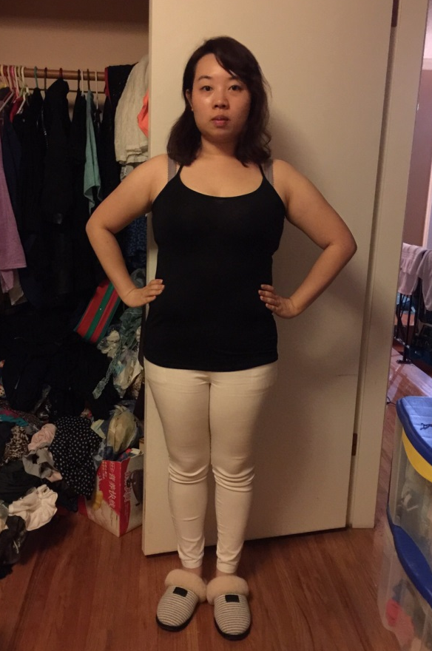
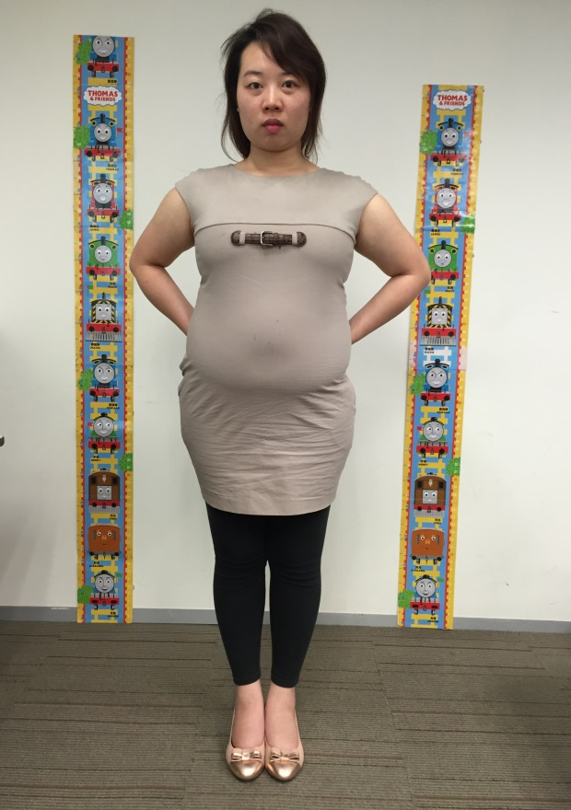
教練Coach: Rayon Lam
1
陳忻婷 Andreol
Before
After
↓32.6磅lbs
↓5.6%脂肪%Fat
↓3.1吋腰圍 Waistline Inch
教練 Coach: May Lun
*見證人的效果因人而異，TLS®補充品為TLS®健康生活纖營計劃的一部份，系統包含健康飲食及運動。
*Results shown in this testimonial may varies between individuals. TLS® supplements are part of The TLS® Weight Loss Solution which includes a healthy diet and exercise.

Slide 15
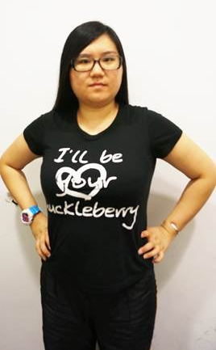
教練Coach: Rayon Lam
2
張錦嫦 Tina
Before
After
↓41.6磅lbs
↓12.1%脂肪%Fat
↓8.5吋腰圍 Waistline Inch
教練 Coach: KC Chan & Michell Ng
*見證人的效果因人而異，TLS®補充品為TLS®健康生活纖營計劃的一部份，系統包含健康飲食及運動。
*Results shown in this testimonial may varies between individuals. TLS® supplements are part of The TLS® Weight Loss Solution which includes a healthy diet and exercise.

Slide 16
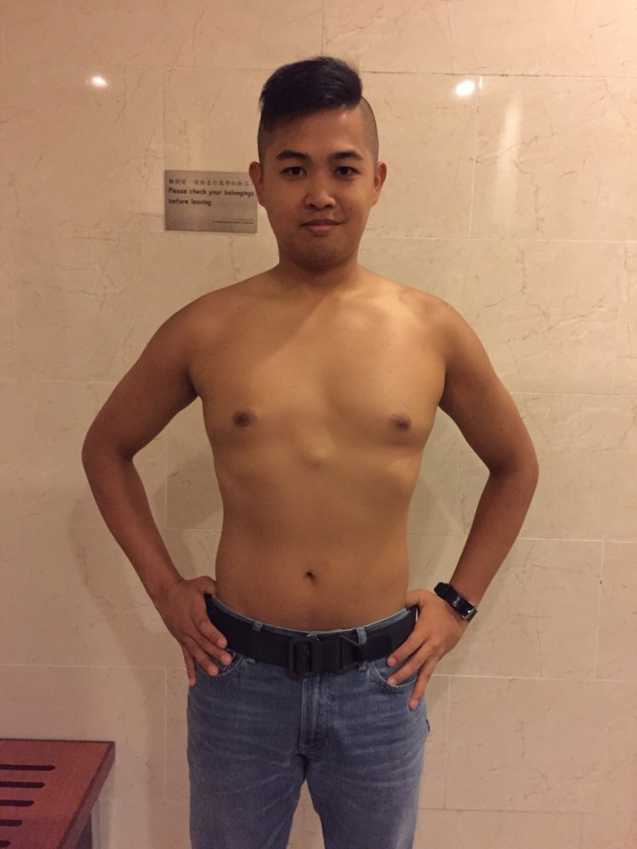
教練Coach: Rayon Lam
3
林嘉偉 Roy
Before
After
↓29.0磅lbs
↓6.8%脂肪%Fat
↓5.5吋腰圍 Waistline Inch
教練 Coach:
Helen Lin & Luk Ka Wai
*見證人的效果因人而異，TLS®補充品為TLS®健康生活纖營計劃的一部份，系統包含健康飲食及運動。
*Results shown in this testimonial may varies between individuals. TLS® supplements are part of The TLS® Weight Loss Solution which includes a healthy diet and exercise.

Slide 17
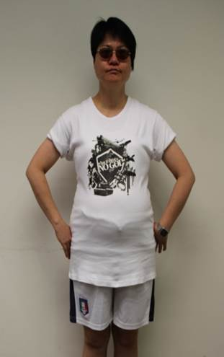
教練Coach: Rayon Lam
4
劉美芳 Fanny
Before
After
↓28.8磅lbs
↓7.9%脂肪%Fat
↓10.2吋腰圍 Waistline Inch
教練 Coach: Pollyanna Chan
*見證人的效果因人而異，TLS®補充品為TLS®健康生活纖營計劃的一部份，系統包含健康飲食及運動。
*Results shown in this testimonial may varies between individuals. TLS® supplements are part of The TLS® Weight Loss Solution which includes a healthy diet and exercise.

Slide 18
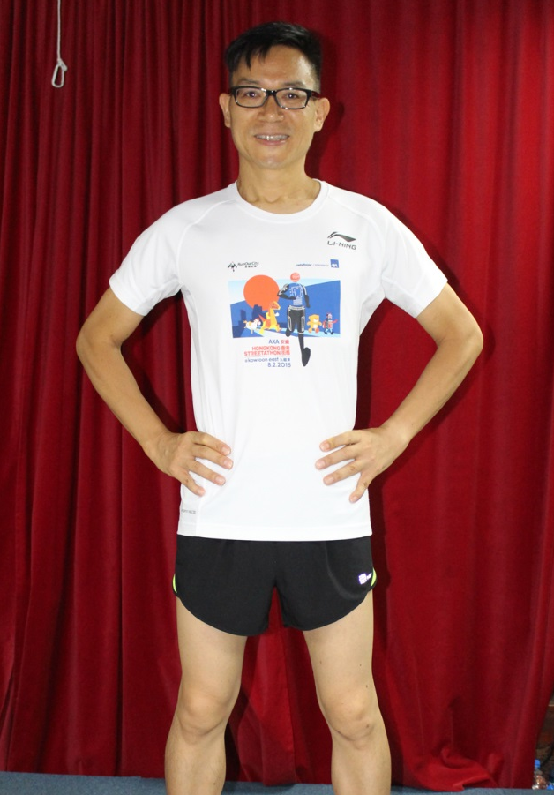
教練Coach: Rayon Lam
5
李家龍 Brian
Before
After
↓35.0磅lbs
↓14.5%脂肪%Fat
↓8.0吋腰圍 Waistline Inch
教練 Coach: Rayon Lam
*見證人的效果因人而異，TLS®補充品為TLS®健康生活纖營計劃的一部份，系統包含健康飲食及運動。
*Results shown in this testimonial may varies between individuals. TLS® supplements are part of The TLS® Weight Loss Solution which includes a healthy diet and exercise.

Slide 19
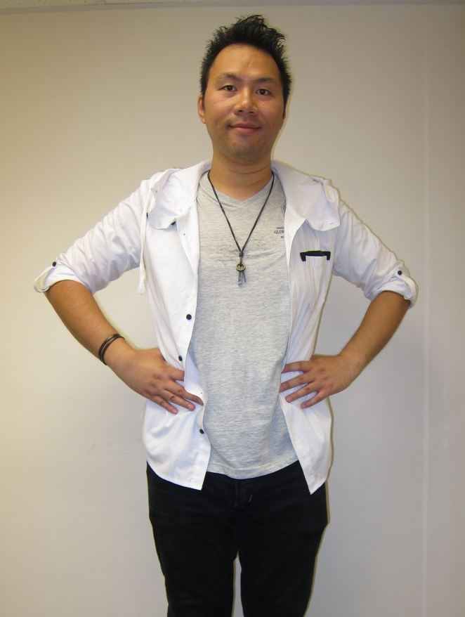
教練Coach: Rayon Lam
6
陸佑銓 Bryan
Before
After
↓41.8磅lbs
↓10.8%脂肪%Fat
↓13.5吋腰圍 Waistline Inch
教練 Coach: Helen Lin & Luk Ka Wai
*見證人的效果因人而異，TLS®補充品為TLS®健康生活纖營計劃的一部份，系統包含健康飲食及運動。
*Results shown in this testimonial may varies between individuals. TLS® supplements are part of The TLS® Weight Loss Solution which includes a healthy diet and exercise.

Slide 20
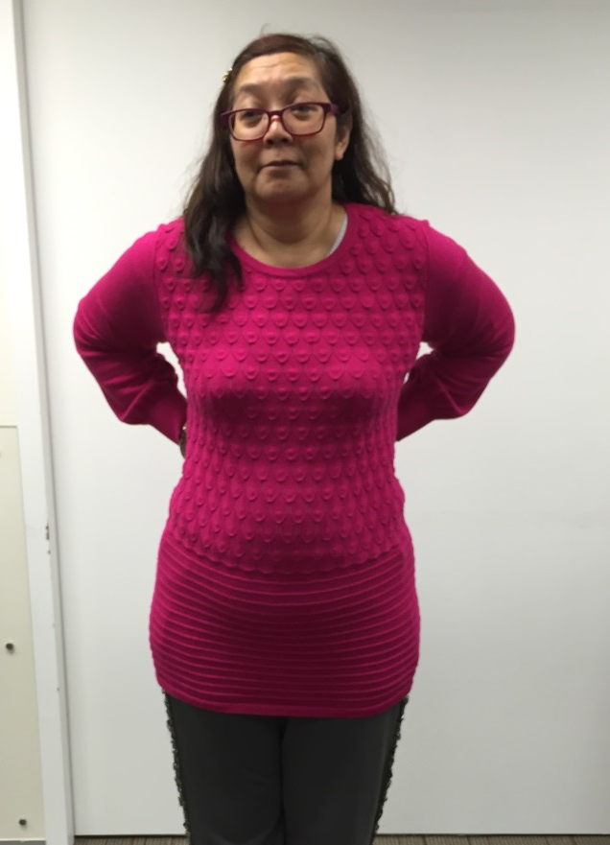
教練Coach: Rayon Lam
7
吳楚霞 Cherry
Before
After
↓36.1磅lbs
↓8.4%脂肪%Fat
↓6.1吋腰圍 Waistline Inch
教練 Coach: May Lun
*見證人的效果因人而異，TLS®補充品為TLS®健康生活纖營計劃的一部份，系統包含健康飲食及運動。
*Results shown in this testimonial may varies between individuals. TLS® supplements are part of The TLS® Weight Loss Solution which includes a healthy diet and exercise.

Slide 21
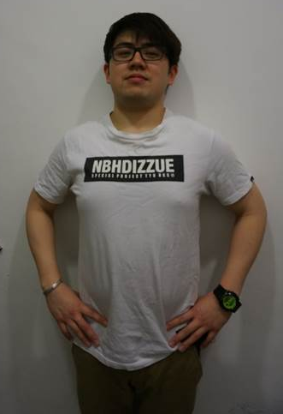
教練Coach: Rayon Lam
8
蘇俊傑 Nic
Before
After
↓28.2磅lbs
↓10.0%脂肪%Fat
↓8.0吋腰圍 Waistline Inch
教練 Coach: KC Chan & Michell Ng
*見證人的效果因人而異，TLS®補充品為TLS®健康生活纖營計劃的一部份，系統包含健康飲食及運動。
*Results shown in this testimonial may varies between individuals. TLS® supplements are part of The TLS® Weight Loss Solution which includes a healthy diet and exercise.

Slide 22
教練Coach: Rayon Lam
9
蕭健兒 Henry
Before
After
↓29.0磅lbs
↓10.2%脂肪%Fat
↓5.8吋腰圍 Waistline Inch
教練 Coach: May Lun
*見證人的效果因人而異，TLS®補充品為TLS®健康生活纖營計劃的一部份，系統包含健康飲食及運動。
*Results shown in this testimonial may varies between individuals. TLS® supplements are part of The TLS® Weight Loss Solution which includes a healthy diet and exercise.

Slide 23
教練Coach: Rayon Lam
10
葉劍鐘 Francis
Before
After
↓30.1磅lbs
↓6.7%脂肪%Fat
↓7.4吋腰圍 Waistline Inch
*見證人的效果因人而異，TLS®補充品為TLS®健康生活纖營計劃的一部份，系統包含健康飲食及運動。
*Results shown in this testimonial may varies between individuals. TLS® supplements are part of The TLS® Weight Loss Solution which includes a healthy diet and exercise.

Slide 24
季軍 2nd RUNNER UP
4
季軍
2nd RUNNER UP
↓41.8磅lbs
↓10.8%脂肪%Fat
↓13.5吋腰圍 Waistline Inch
教練 Coach: Helen Lin & Luk Ka Wai
#6 陸佑銓 Bryan

Slide 25
亞軍 1st RUNNER UP
4
↓41.6磅lbs
亞軍
1st RUNNER UP
↓12.1%脂肪%Fat
↓8.5吋腰圍 Waistline Inch
教練 Coach: KC Chan & Michell Ng
#2 張錦嫦 Tina

Slide 26
冠軍 CHAMPION
4
冠軍
CHAMPION
↓35.6磅lbs
↓13.6%脂肪%Fat
↓9.5吋腰圍Waistline Inch
#1 李家龍 Brian
教練 Coach: Rayon Lam

Slide 27
年度最佳TLS®教練
Best TLS® Coach of the Year
以百分制為參賽者評分：
50% － 帶領新加入美安香港的超連鎖™店主或優惠顧客參加比賽的人數
50% － 成功完成整個比賽的學員人數及學員的整體成績
Score based on a 100-point scale:
50% - No. of new Market Hong Kong Preferred Customer or UnFranchise™ Owner leading into the contest
50% - No. of participants successfully finish the contest and their overall results

Slide 28
年度最佳TLS®教練
Best TLS® Coach of the Year
成功完成比賽人數% % of results returning
學員整體成績
Overall results of the participants
雙冠軍 Double Crown

Slide 29
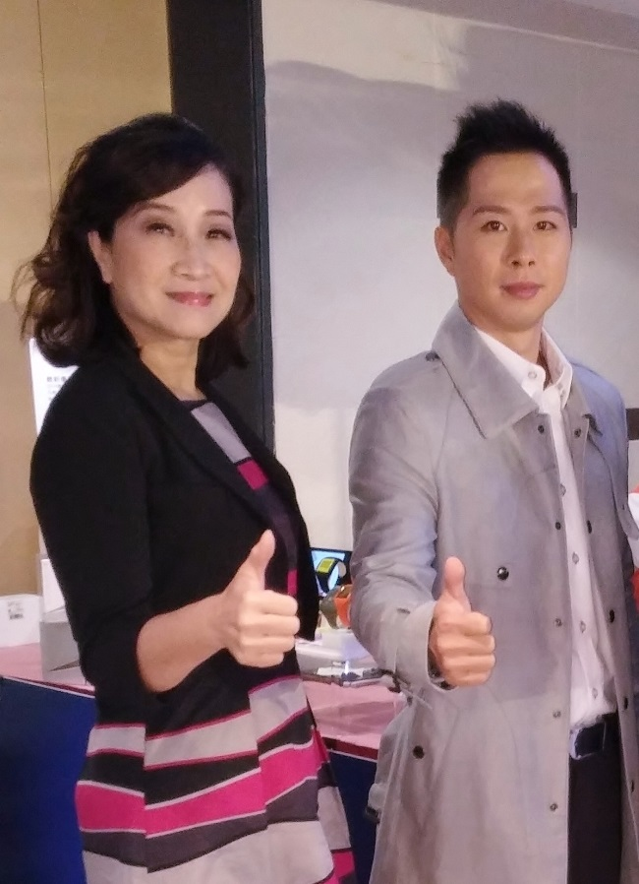
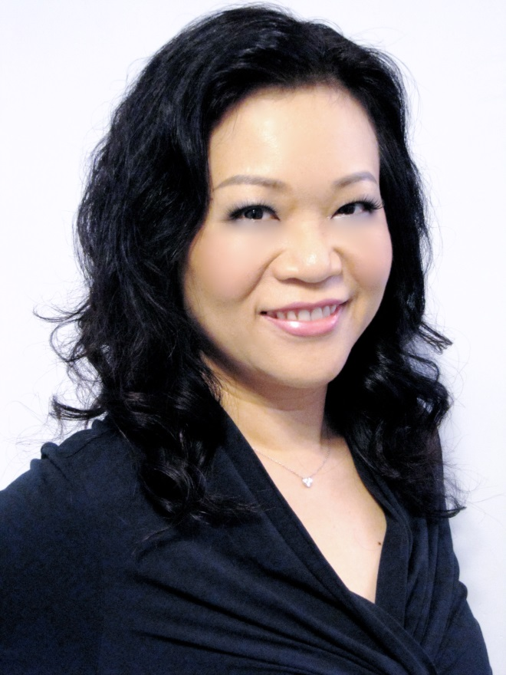
年度最佳TLS®教練
Best TLS® Coach of the Year
KC Chan & Michell Ng
May Lun

Slide 30
隆重介紹 INTRODUCING THE
TLS 21 天減重挑戰
TLS 21 DAY CHALLENGE
只需3星期，塑造全新的你
REVEAL A NEW YOU IN JUST THREE WEEKS
START LIVING WITH TLS TODAY
#FINDYOURFIT
#TLSWEIGHTLOSS
Notes:
Brief introduction and play the video clip

Slide 31
TLS 21 DAY CHALLENGE
即將登場
COMING SOON
第一階段 – 淨化排毒
第1–7日
第二階段 – 燃燒脂肪
第8–21日
START LIVING WITH TLS TODAY
#FINDYOURFIT
#TLSWEIGHTLOSS

Slide 32
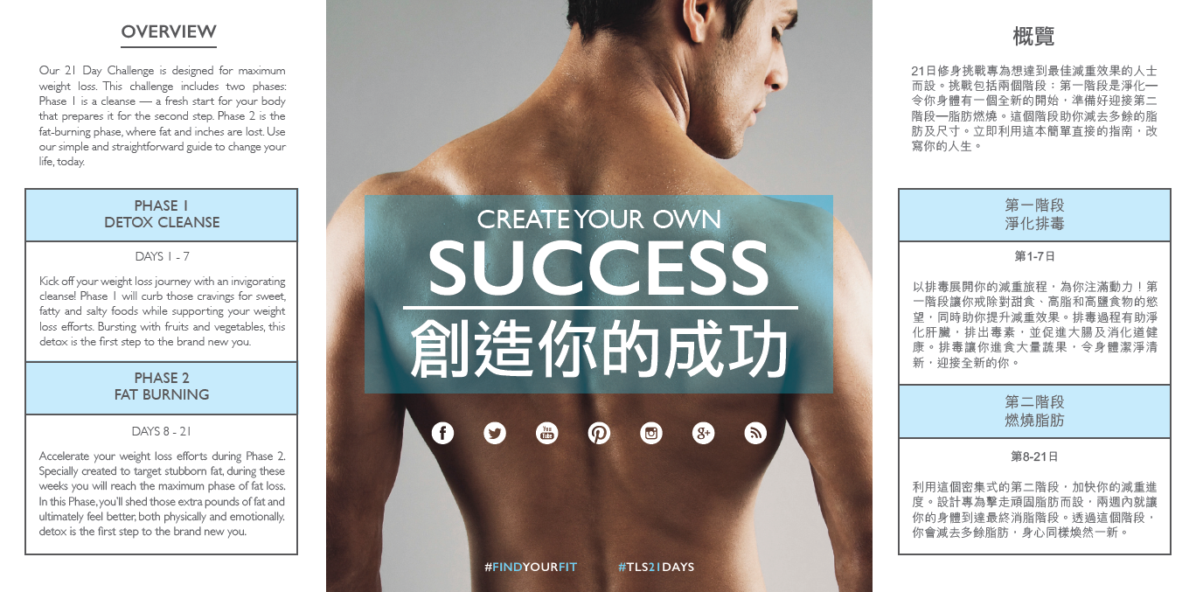
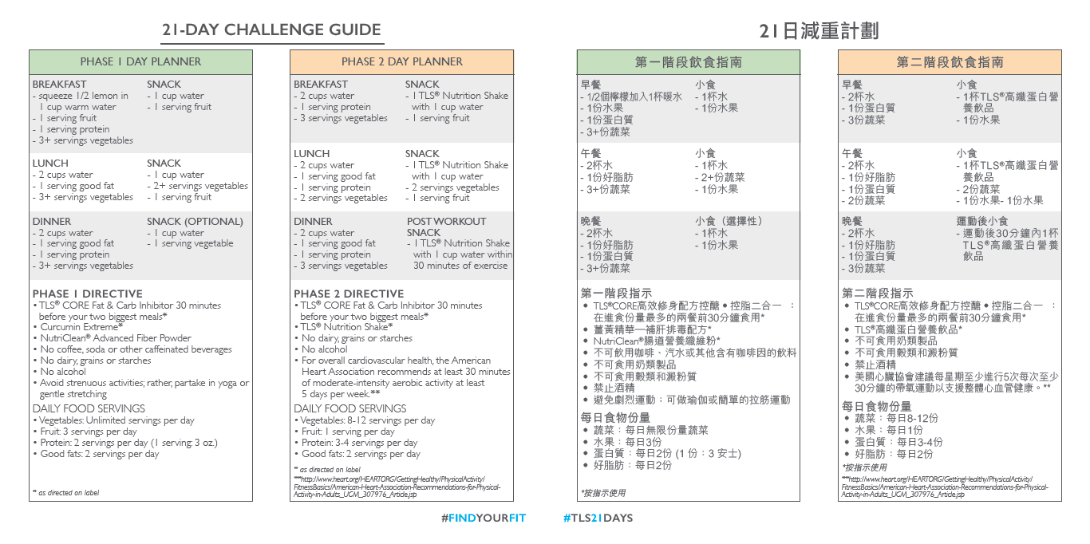
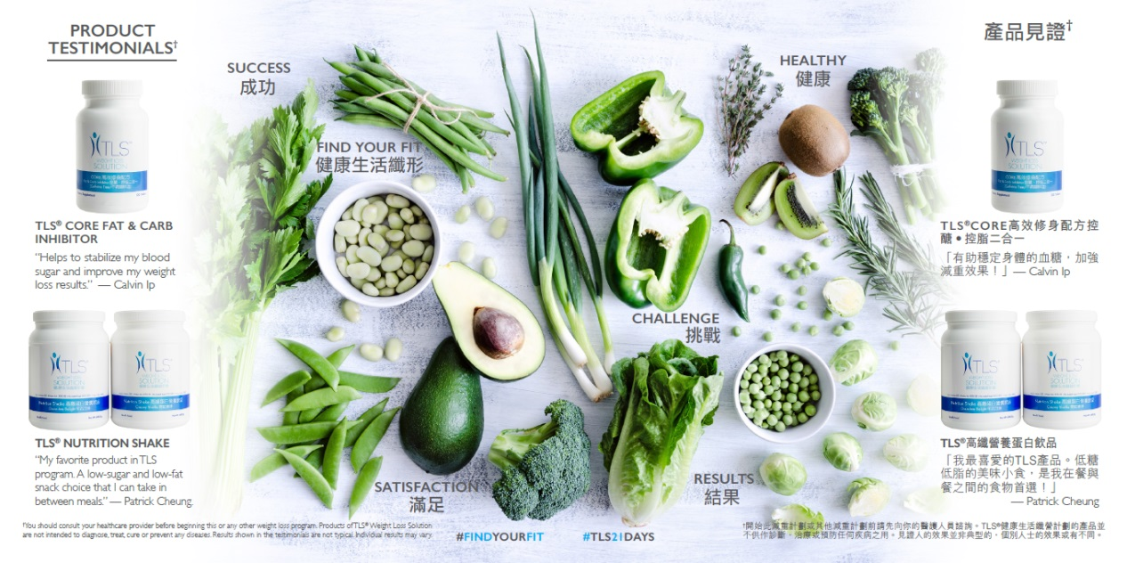
Notes:
Play the Dennis TLS 21 day challenge clip

Slide 33
密切留意更多資訊
For more information
9月17日晚上8點至10點
September 17, 8 -10 pm
10月10日下午3點至5點
October 10, 3 – 5pm
#FINDYOURFIT
D
START LIVING WITH TLS TODAY
#TLSWEIGHTLOSS

Slide 34
TLS®授證教練
TLS® Certified Coach
TLS®授證訓練員
TLS® Certified Trainer
2012
2013
2015
2010
TLS®健康生活纖營比賽
TLS® Find you Fit Challenge
START LIVING WITH TLS TODAY
#FINDYOURFIT
#TLSWEIGHTLOSS
Notes:
Play the Dennis TLS 21 day challenge clip

Slide 35
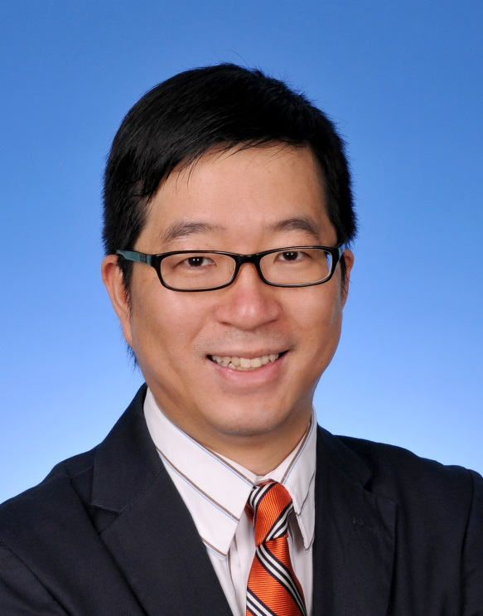
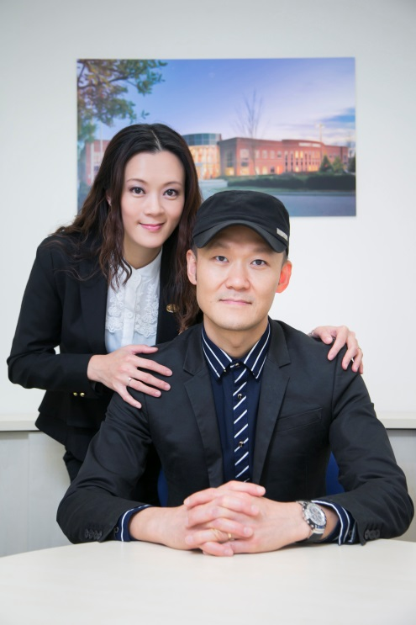
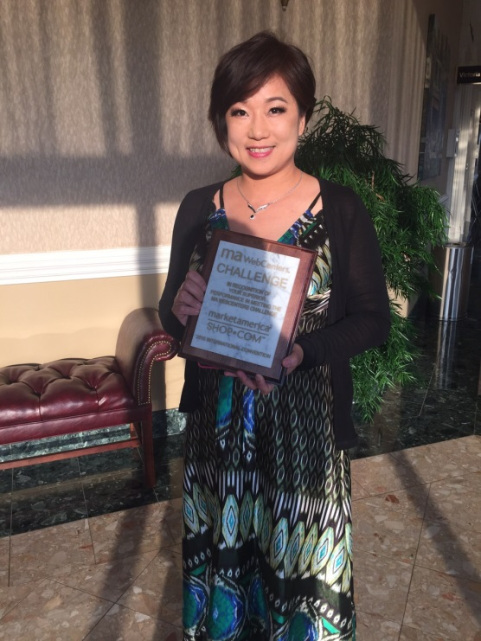
TLS®授證訓練員
TLS® Certified Trainer
Calvin Ip
Helen Lin & Luk Ka Wai
Maggie Su

Slide 36
2015 美安香港成功領袖會議
MHK Leadership Conference 2015

